Slide 1

10 Most Common Mistakes Made by Chinese Writers of Emails
Copyrighted: 10/31/2011

Slide 2
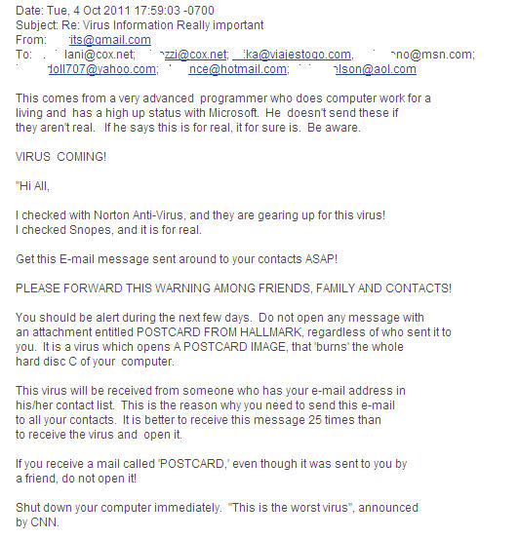
#10: Forwarding offensive, obscene letters or virus hoaxes
Sounds real
You want to help your friends
Sounds urgent
Most of the time, these are hoaxes

Slide 3

#10: Forwarding offensive, obscene letters or virus hoaxes
Why not forward?:
  Wastes your friend’s time (do the math)
  If offensive/obscene, it hurts your reputation
  You cannot “undo” the damage
  You can be fired
Notes:
Companies own your computer and the email system. They can and do monitor.

Slide 4
#9: Overuse of Abbreviations
ASAP – As soon as possible
FYI - For your information
BTW - By the way
LOL - Laughs out loud
BCNU - Be seeing you
FWIW - For what it's worth
IMHO - In my humble opinion
OBO - Or best offer
ROTFL - Rolling on the floor laughing
RTFM - Read the funny manual
TNSTAAFL - There's no such thing as a free lunch
TTFN - Ta ta for now
TTYL - Talk to you later

Slide 5

#7: Overuse of High Priority Option
五十步笑一百步
Can be viewed as impolite if overused

Slide 6
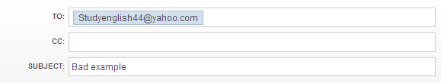
Leaving Out Message Thread
Dear Ed,
Here’s the information you asked for in your email last week:
1) I will work on it ASAP
2) No one mentioned this before so we will try again
3) Would you call me on this one? I need more information.
Take care,
Joe
Notes:
Manager are busy and may not remember what they wrote a few days ago.

Slide 7

#6: Using Email to Discuss Confidential Information
Emails can and will be forwarded
Email could end up in the wrong hands
Computers belong to the company and they have the right to monitor it

Slide 8
#5: Long Run-on Sentences
In respect that consequences of certain kind of things may vary in accordance with the diversity of both situation and position, it has triggered a flood of discussions whether it is wise to destroy the historic buildings and replace them with modern ones. Most people always find themselves in such a dilemma that they are unwilling to sacrifice one for another.
However, I am in favor of the idea that we should maintain and preserve historic buildings, because many people never fail to ignore that old historic buildings offer us both spiritual and the lifeless man-made objects, but the spiritual places for the native to memorize their primogenitors, think about their past, cherish the present, and look forward to the glorious future.

Slide 9
Dear Mr. Jones,
I’m a university student from Finland and I’m writing to get some information about your language courses this summer. I’ve got a few questions:
1. Do you do a course for university students, which helps them with their essay writing skills?
2. How many hours a week are the courses?
3. What sort of accommodation do you offer?
4. What after-school activities are there?
5. Do you do any trips to other towns in the UK?
I’m hoping to come over in June, so if you can get back to me as soon as possible, it would be great. Thanks for your help.
Best regards,
Notes:
Bullets make the points clear.

Slide 10
#4 – Writing In All CAPITALS
DEAR ED,
THANK YOU FOR MEETING WITH ME TO DISCUSS OUR POSSIBLE JOIN VENTURE. I’M SURE IT WILL BE A WIN-WIN FOR US.
PLEASE LET ME KNOW WHEN WE CAN MEET AGAIN.
SINCERELY,
JOE

Slide 11
#3: Formatting Errors
Below is the opening comments to impress the women’s club members:
“Woman, with out her, man would be a beast!”
(mistaken location of commas):
“Woman with out her man, would be a beast!”
Notes:
1) When writing a business e-mail, format it in plain text rather than HTML. Not all e-mail clients can read HTML. 2) do not use dates in xx/xx/xxxx format. Different countries use different order. 3) be careful of attachments. Some read their email from a phone and cannot read files and some do not have the latest version of Word. 4) avoid emotion icons

Slide 12
#2: Using Meaningless Subject Lines
“Hello” – no meaning for recipient
“Meeting” – which meeting? When?
“Urgent” – no useful details (deadline?)
“Question” – most emails have questions
Avoid “spammy” subjects
Follow the example of newspapers (titles)
Most important 50 characters

Slide 13
#1: Not Proofreading Emails
You only have one time to make a good first impression
Make use of “Draft” folder for “hot’ replies
Read important email aloud
Be careful of: Homonyms (our/are, their/there, buy/by, to/two/too, right/write)
“Time well spent”

Slide 14
Review: What’s wrong with this:
Subject: Hello!
Hi Jack!!!
My name’s Jaana and I’M FROM FINLAND!!! I bet you haven’t had students from here B4 ;-) ;-) That’s probably coz we’re so amazing at languages, that we don’t need any xtra help?except me – I need all the help I can get!! FYI: the problem really started when I was in primary school, and my parents, who had been arguing non-stop since I was a little baby, got divorced and decided that I should be adopted as they couldn’t decide who should have custody of me. Anyway, this was all a bit traumatic, so all my school subjects suffered ☹, especially English. HAHAHAAA ONLY JOKING!!!! :-) (Actually, don’t tell anyone, but I’m actually quite a good student? but if anyone found out, my reputation would be ruined, so shhhhhh!) BTW do u do courses for uni students? How many lessons/week? Is there any extra stuff after school, SO I CAN MEET SOME COOL PEOPLE ☺ ☺? How about trips? Give me all the info you can, man!!!!!
Jaana (although all my mates call me Jakki!!)

Slide 15

Replies With Purpose
Example of pre-emptive reply resulting in one reply:
Customer: Can you tell me where I can purchase your product?
Sales: Thank you for your mail. You can purchase our product online from: http://www.company.com. We accept VISA and MasterCard. For your information I have attached our price list. Let me know if you have any further questions.

Slide 16

Examples of Bad Replies:
1) Customer: “Is my problem fixed?”
Reply from Service Rep: “No.” (no reason, no details, no estimate)
2) Manager to team: “I need this done ASAP.”
Question: Does that mean stay late to work on it or whenever it is “possible”. (needs target date)
Please think first

Slide 17
Don’t:
Write ‘hello’ as your subject line.
Give personal information (emails get forwarded)
Use capital letters to write whole words as in emails (this is considered shouting and impolite)
Use different fonts in the email (the recipient’s computer may not be compatible)
Use Italics (the reason may be misunderstood, due to cultural differences)
Over use exclamation marks
Use abbreviations like coz and uni (the recipient may not understand)
Use smileys (they may be misunderstood and viewed as unprofessional)

Slide 18
Good Email Writers Do This:
Use an informative subject line, which says what the email is about.
Write the most important information first.
Use numbers and bullet points to make the message clearer.
Use simple grammar. (Emails are a fast means of communication, they should be less wordy and complex than formal letters.)
Write short sentences.

Slide 19
Resource Links:
Search Acronyms & Abbreviations: www.abbreviations.com/
Dictionary of acronyms & abbreviations: www.acronymfinder.com/
Dictionary of idioms: http://idioms.thefreedictionary.com/
Business letter samples:
www.4hb.com/letters

